Slide 1

SI100B Introduction to Information Science and Technology (Python Programming)
高盛华
School of Information Science and Technology
ShanghaiTech University
Slides credited to Prof Haipeng Zhang

Slide 2
Instructor for programming
Instructor: Shenghua Gao
Research
Computer Vision
Machine Learning
Office: Room 1A-304.C, SIST Building 1
Email: gaoshh@shanghaitech.edu.cn
Web: https://sist.shanghaitech.edu.cn/2020/0707/c7499a53902/page.htm
Office hour: Wed 2:00-3:00 pm

Slide 3






高盛华
研究员/博导
中组部青年千人计划/微软学者/浦江人才/ACM青年科学家奖/曙光学者
上海科技大学-旷世科技联合实验室主任
教育背景：
2008.08 – 2012.06 新加坡南洋理工大学 博士
2004.09 – 2008.07 中国科学技术大学 学士
工作经历：
2014.08 - 上海科技大学 研究员/博导
2015.01 - 2015.06 加州大学伯克利分校 访问教授
2012.06 - 2014.08 美国伊利诺伊大学新加坡高等研究院 研究科学家

Slide 4
Instructor for signal processing
Instructor: 娄鑫 Xin Lou
Research
Integrated Circuits for Computer Vision
Digital VLSI
Office: Room 1D-303.E, SIST Building 1
Email: louxin@shanghaitech.edu.cn
Web: https://sist.shanghaitech.edu.cn/2018/0502/c2739a24281/page.htm

Slide 5




娄鑫
研究方向：智能视觉芯片，超大规模数字集成电路
教育背景
2012-2016 | 新加坡南洋理工大学 | 电子工程 博士
2010-2012 | 瑞典皇家工学院 | 片上系统设计 硕士
2006-2010 | 浙江大学 | 电子信息技术及仪器 学士
工作、实习经历
2017-至今 | 上海科技大学信息科学与技术学院 | 助理教授，研究员，博导
2016.4-2017.2 | 新加坡南洋理工大学 | 研究科学家

Slide 6
Instructor for electronics
Instructor: 梁俊睿 Junrui Liang
Research
Self-powered Internet of Things 自供能物联网
Power electronics 电力电子
Mechatronics 机电一体化
Office: Room 1D-303.D, SIST Building 1
Email: liangjr@shanghaitech.edu.cn
Web: http://metal.shanghaitech.edu.cn

Slide 7




梁俊睿
研究方向：自供能物联网，电力电子，机电一体化
教育背景
2007-2010 | 香港中文大学 | 机械与自动化工程 博士
2004-2007 | 上海交通大学 | 精密仪器与机械 硕士
2000-2004 | 上海交通大学 | 仪器科学与技术 学士
工作、实习经历
2013-至今 | 上海科技大学 信息科学与技术学院 | 助理教授，研究员，博导
2015-2016 | 美国加州大学伯克利分校 | 访问学者者
2013 | 香港城市大学 | 博士后研究员
2010-2012 | 香港中文大学 | 博士后研究员

Slide 8
PP Arrangement
TAs for programming part
秦琦 qinqi@shanghaitech.edu.cn
高子淇 gaozq@shanghaitech.edu.cn
张龙文 zhanglw2@shanghaitech.edu.cn
邬一闻 wuyw1@shanghaitech.edu.cn
张晨杨 zhangchy1@shanghaitech.edu.cn
陈昱聪 chenyc@shanghaitech.edu.cn
刘新航 liuxh2@shanghaitech.edu.cn
曹宇涵 caoyh1@shanghaitech.edu.cn
Related inquiries
Google, StackOverflow
Ask on piazza
Email, put SI100B in titles
Do email TA if you have any problem regarding the course

Slide 9
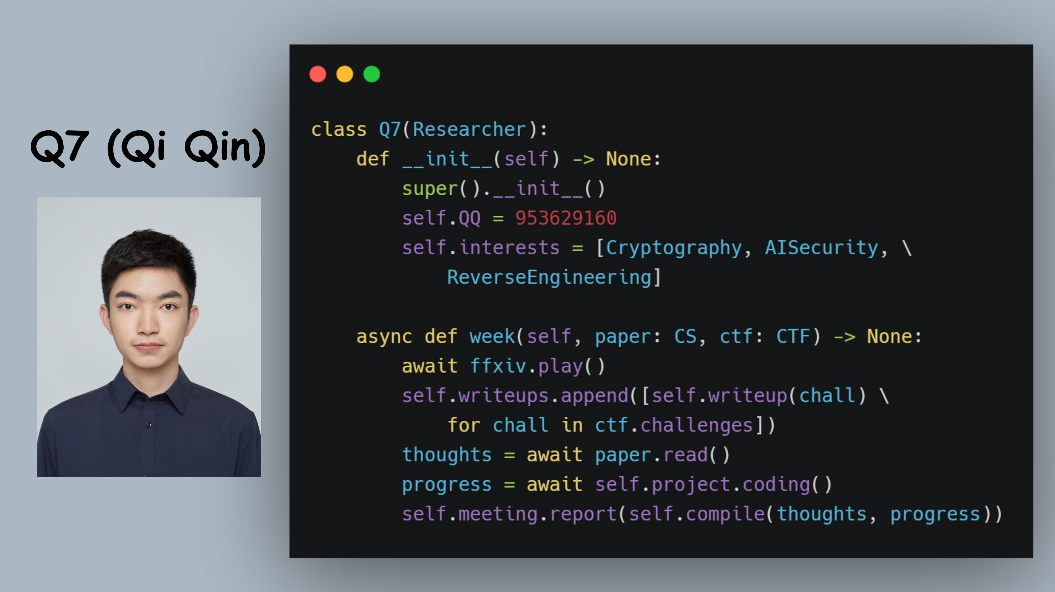

Slide 10
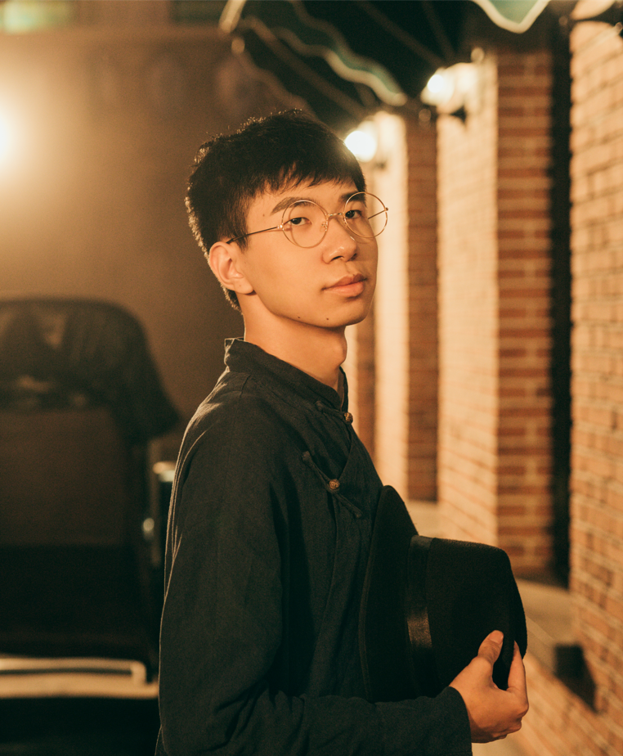
曹宇涵
20级本科生，major in CS
在能放的照片里找了一张不那么羞耻的
音乐社现任社长，暂未退休
一个乐器都不会
（应该）吃不胖，截止今日没有打破该flag
Unity作业整了个恐怖游戏成功吓到助教
除了这句话之外能找到SI100B相关的内容就是我输了
QQ 861940148，微信用的不多

Slide 11
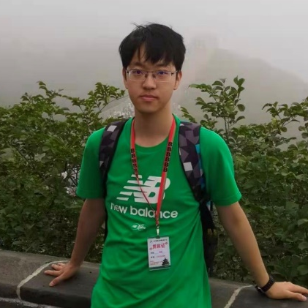
基本信息：
邬一闻 (wuyw1@shanghaitech.edu.cn)
2019级本科生CS专业
个人介绍：
三年编程经验（两年+熬夜=三年）
主要研究风格迁移方向（目前还是菜鸡）
JRPG玩家、LOL玩家、yj的利刃、米卫兵…

Slide 12
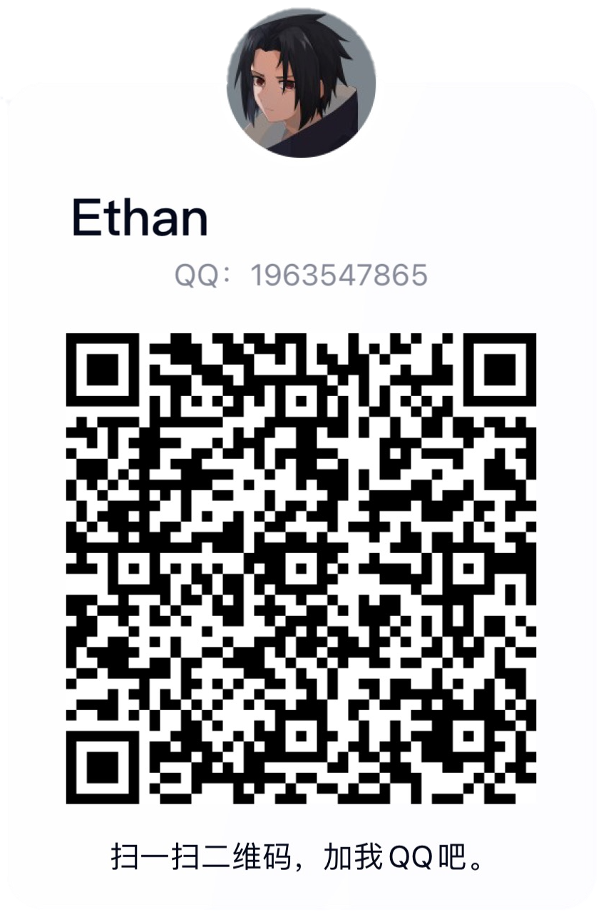
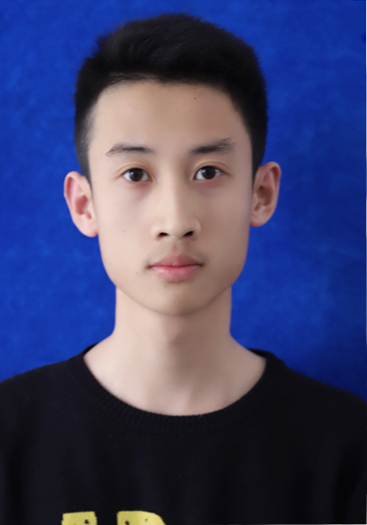
陈昱聪
2019 undergraduate, SIST
Come and find me in SIST 1A-311 ;)
chenyc@shanghaitech.edu.cn
Ask me about anything if you want! Not just for this course~ ≡ω≡
The first step to become a scientist or an engineer — Enjoy programming!
QQ, for your convenience
When I was young…

Slide 13
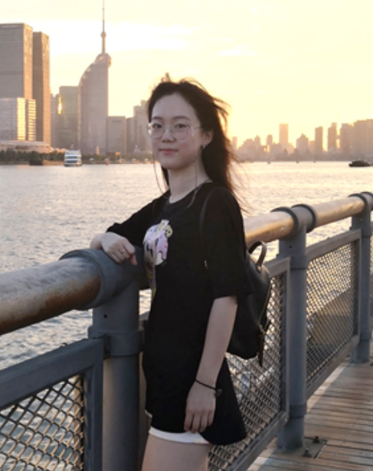
Ziqi Gao 高子淇
Research Interest:
Medical Image Computing
Computer Vision
Machine Learning
Education & Teaching Background:
2018-2022: ShanghaiTech University, Computer Science, BE.
TA for SI100B in 19 Spring, 20 Fall, 21 Fall.
TA for CS240 (Algorithm Design & Analysis) in 21 Spring.
Location: SIST 2-307
Email: gaozq@shanghaitech.edu.cn
WeChat: Z7GaoGao

Slide 14
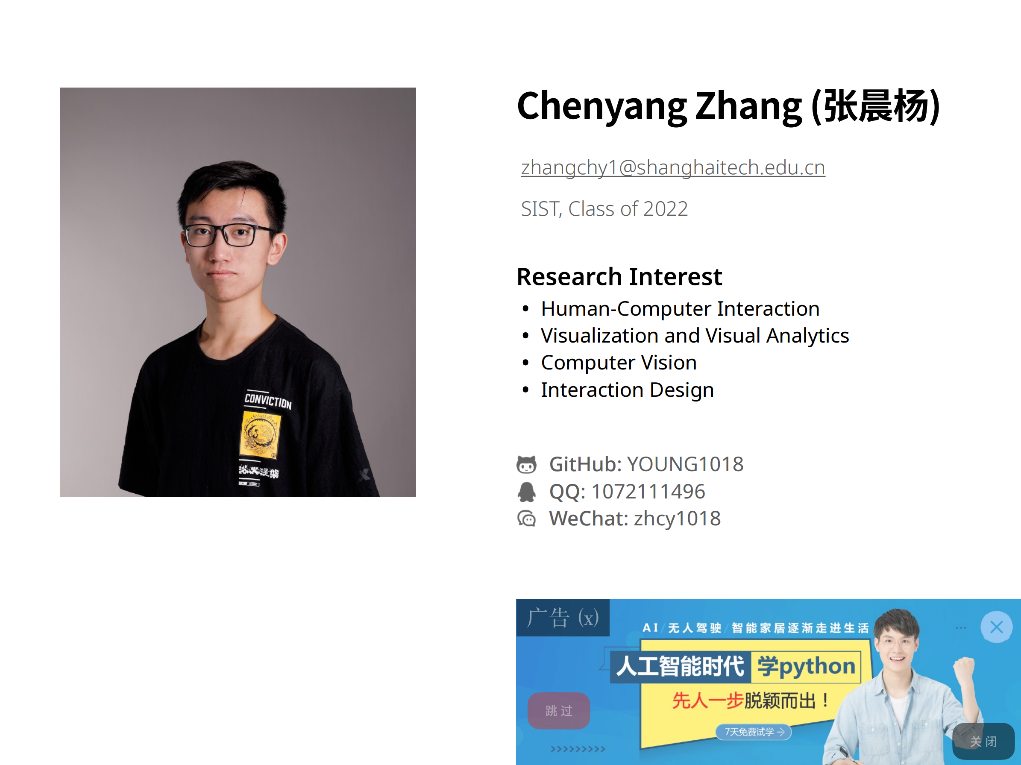

Slide 15
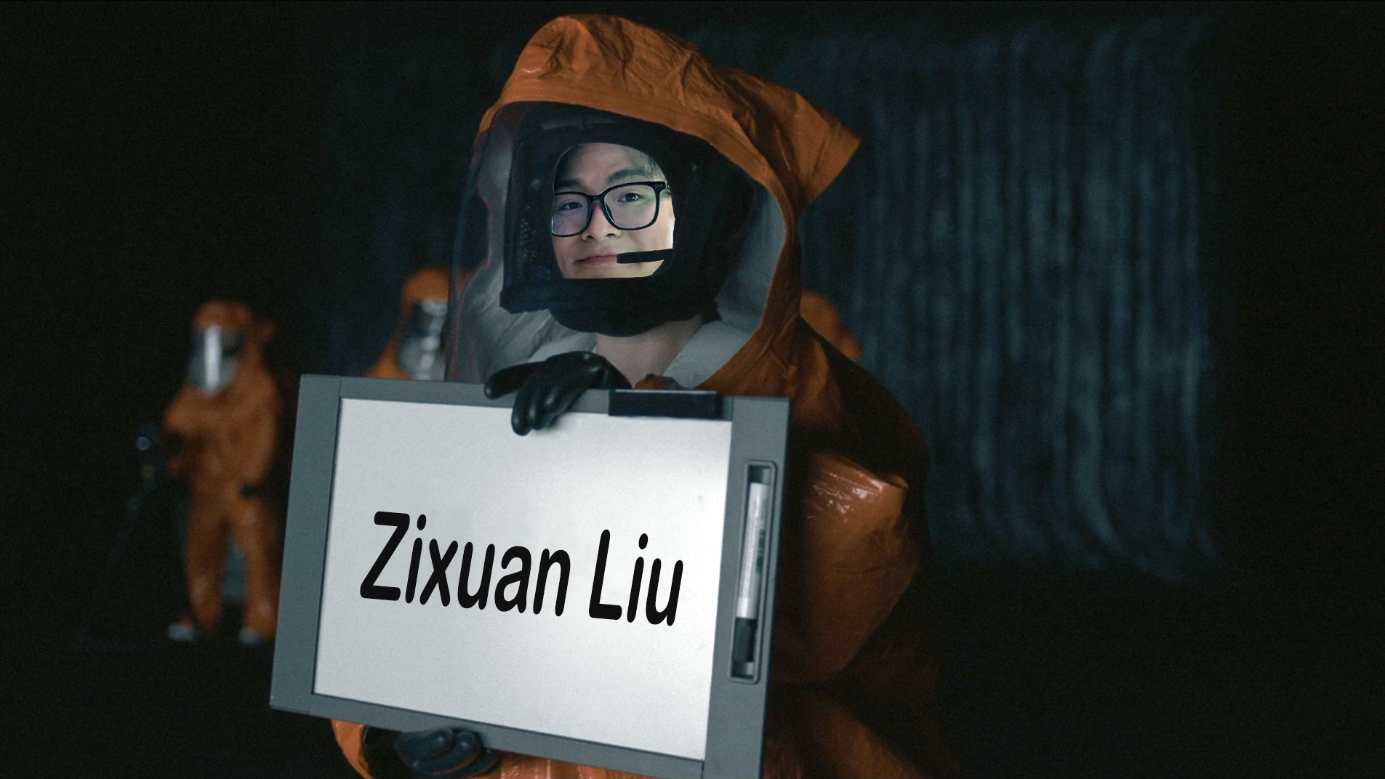
Project Part TA
Mail: liuzx@..
QQ: 1127312162
Very friendly!

Slide 16
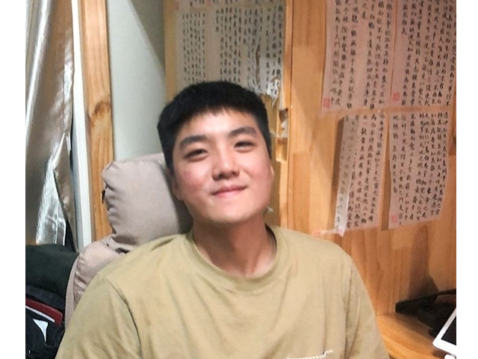
Name: Xinhang Liu
Grade: 2018
Hobby: Basketball
liuxh2@shanghaitech.edu.cn

Slide 17
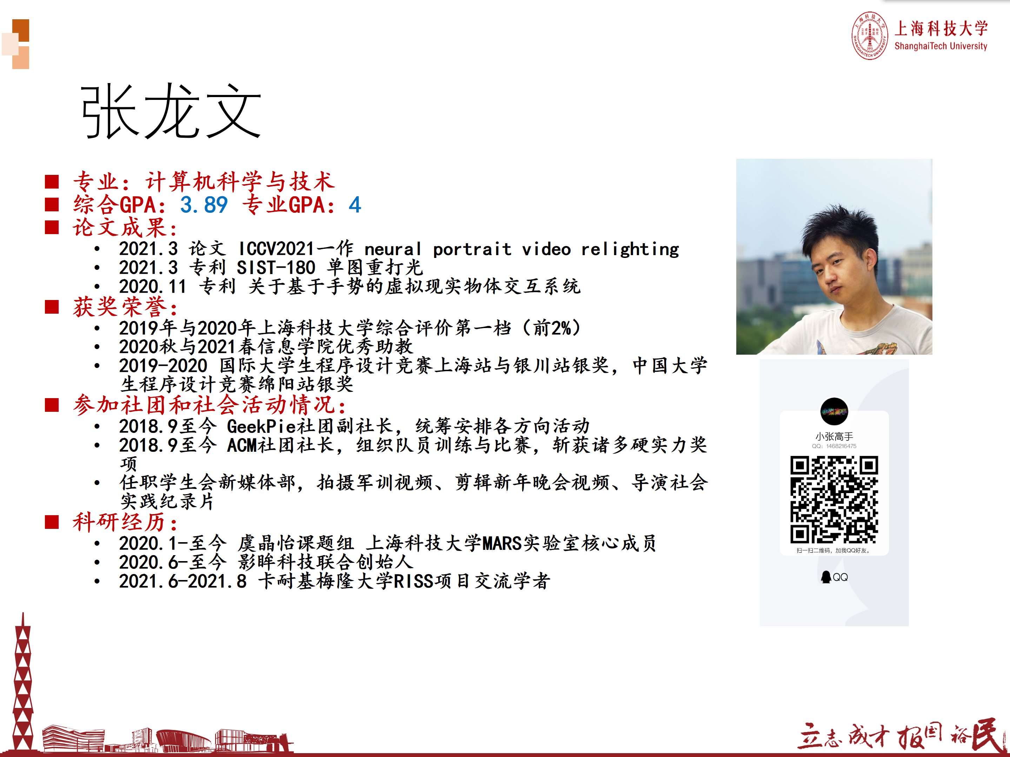

Slide 18
SI100B
24 lectures on Wed&Fri, for the first 12 weeks
1. Python programming (PP), 8 lectures, 20% of the total score
2. Signal processing (SP), 8 lectures, 20%,
3. Electrical and electronic technologies (EE), 8 lectures, 20%
Project (PJ) during the last 4 weeks
Choose 1 from 5 projects, each one with a different focus: programming, signal processing, electronics
40%, details to be announced later in the semester
Miscellaneous
For PP, SP, EE, and PJ, each may include bonus scores up to 10% of the score for the corresponding part. E.g PP may take up to 22% of the total score

Slide 19
Python Programming
Goals
Learn Python as a computational and engineering tool.
Be successful in science, engineering, business, and other professions.
Reference: www.python.org, Python 3.7
The Python Tutorial
The Python Language Reference, core syntax and semantics
The Python Standard Library, exact syntax and semantics
The Python HOWTOs, guide for specific tasks
Learning Python (《Python学习手册》), 5th Edition, Mark Lutz
Slides, discussions, assignments, announcements on Piazza:
Register using your real Chinese names and ShanghaiTech emails.
Check Piazza and email daily. Don’t miss out important messages.
Gradescope: www.gradescope.com
for submitting some paper&pen (non-programming) assignments and we will publish your scores on it.

Slide 20
Signal Processing
Goals
To provide an introduction to signal and signal processing
Familiarize the students with signal processing using MATLAB
Reference books
Richard G. Lyons, Understanding Digital Signal Processing
Alan V. Oppenheim and Ronald W. Schafer, Discrete-Time Signal Processing, 3rd Edition
Sanjit K. Mitra, Digital Signal Processing: A Computer-Based Approach, 4th edition
Notes:
把记录在某种媒体上的信号进行处理，以便抽取出有用信息的过程，它是对信号进行提取、变换、分析、综合等处理过程的统称。

Slide 21
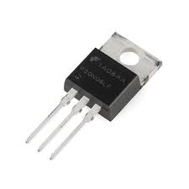
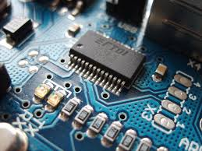
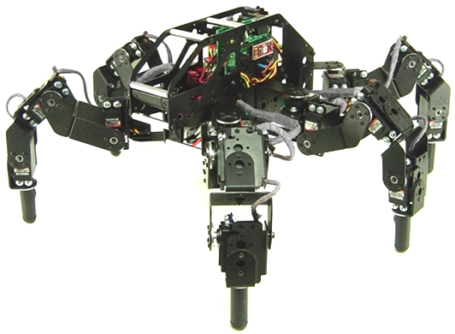
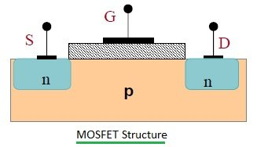
Electronics
Goals
Reference books
Sarah Harris, David Harris, Digital Design and Computer Architecture. ARM Edition, Morgan Kaufmann, 2015, ISBN 978-0-12-800056-4. (电子版https://b-ok.as/book/2716132/efaeba?regionChanged)
Device Circuit System
Notes:
课程目标，认识组成电子系统的三个层次的技术：器件（Device），电路（Circuit），系统（System）

Slide 22
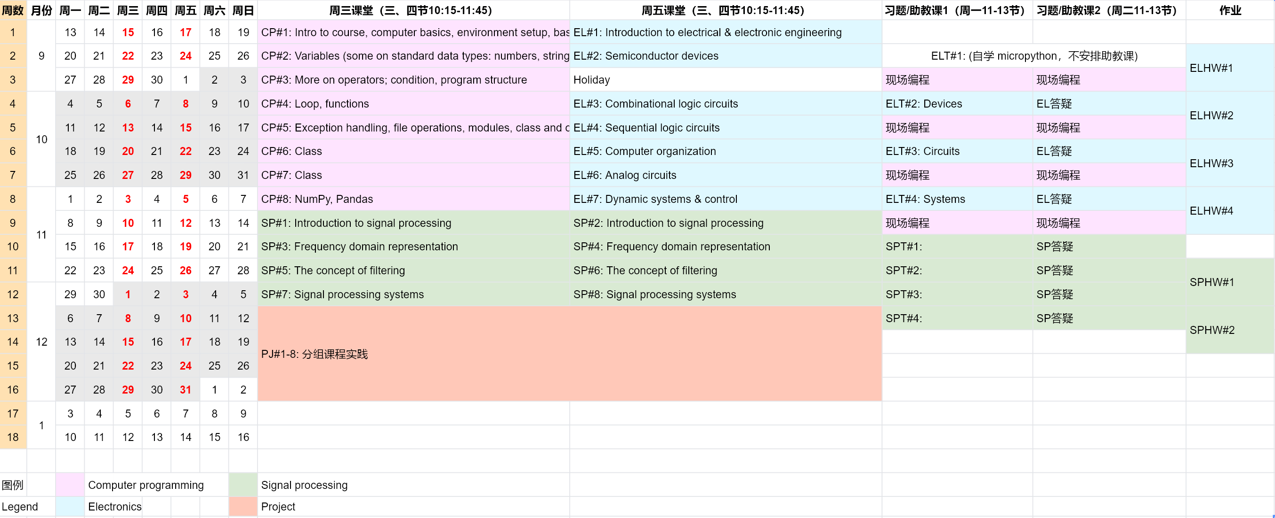
Course Arrangement
Tutorial time may be adjusted based on the arrangement of National Public Holidays…

Slide 23
Programming Arrangement
8 lectures
3 on-site programming assignments
Week 5/7/9 20% 20% 20% （Two groups: Mon or Tue 6:55pm-9:30pm）
Week 3 TAs teach you how to program and debug…
Quizzes (30%), in class
Lecture | Content
1 | Intro to course, computer basics, environment setup, basics about print, comments, and control flow
2 | Variables (some on standard data types: numbers, string, list, tuple, dict), Expressions (some about operators), Statements
3 | More on operators; condition, program structure
4 | Loop, functions
5 | Exception handling, file operations, modules, class and objects
6 and 7 | Class
8 | NumPy, Pandas

Slide 24
Academic Integrity
The university code on academic integrity
http://openinfo.shanghaitech.edu.cn/xswyhxgzdjjy/list.htm
We DON’T tolerate academic misconducts
抄袭他人代码，抄袭网络源代码(Github, CSDN等)
反编译别人的编译后文件(.pyc)
散布源代码
帮助或者寻求别人帮助修改代码问题(debug)
代他人签到
不允许提供抄袭，保护好自己的代码
鼓励讨论，仅限于算法层面，不允许讨论与借鉴实现细节

Slide 25
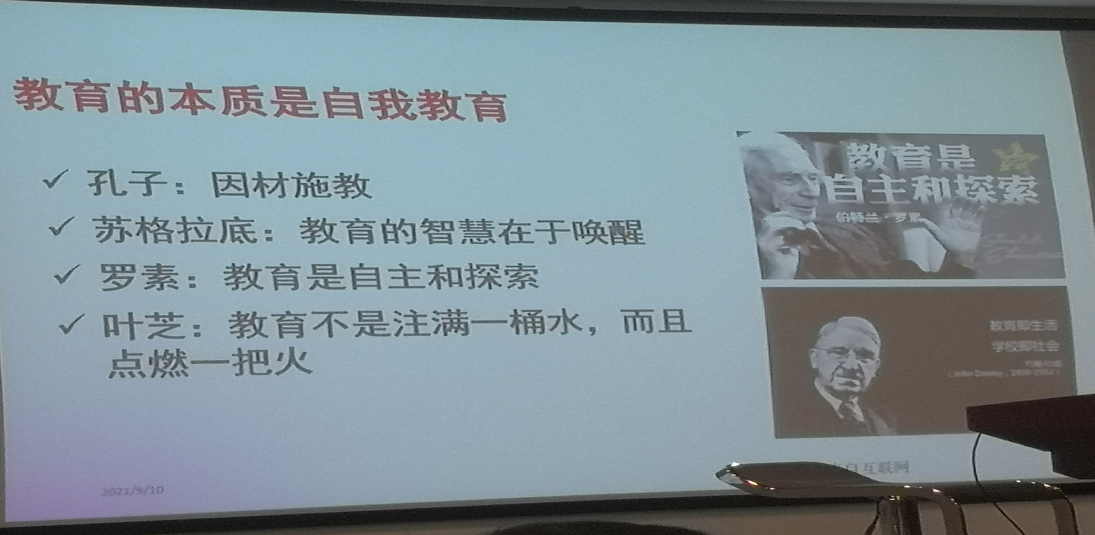
How to learn Python Effectively
Learning by doing
Slides credited to Prof Yang Yang

Slide 26
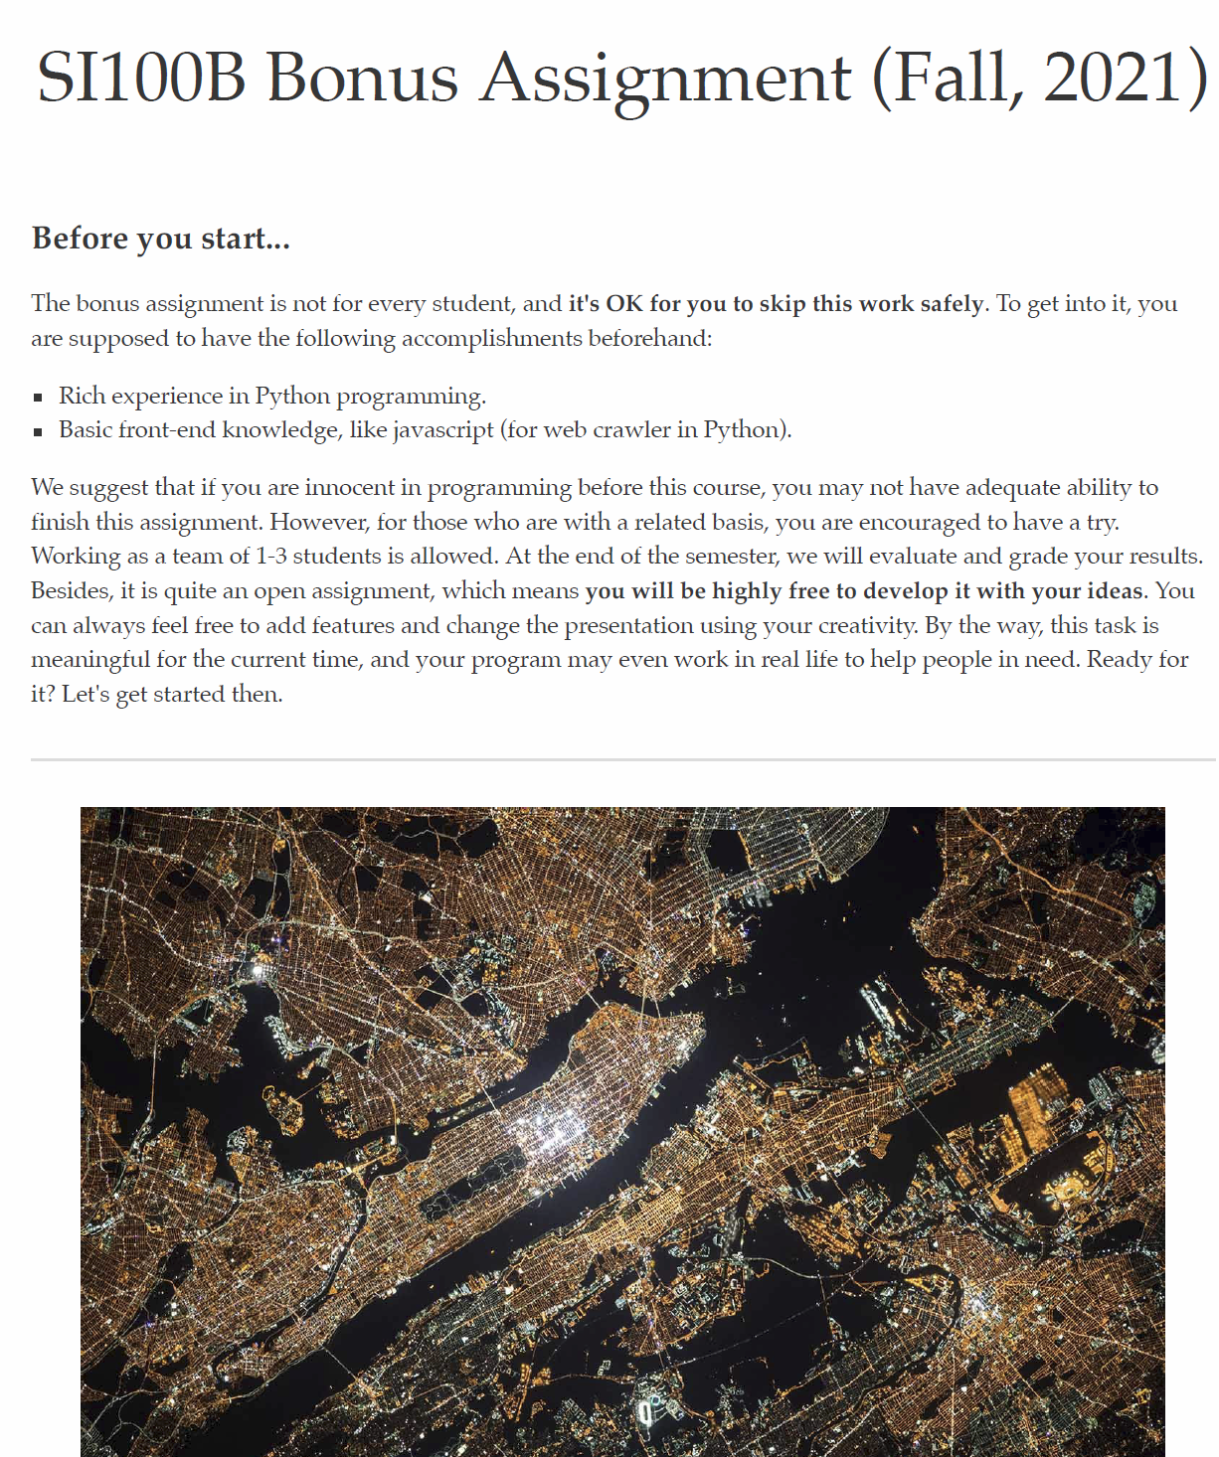

Slide 27
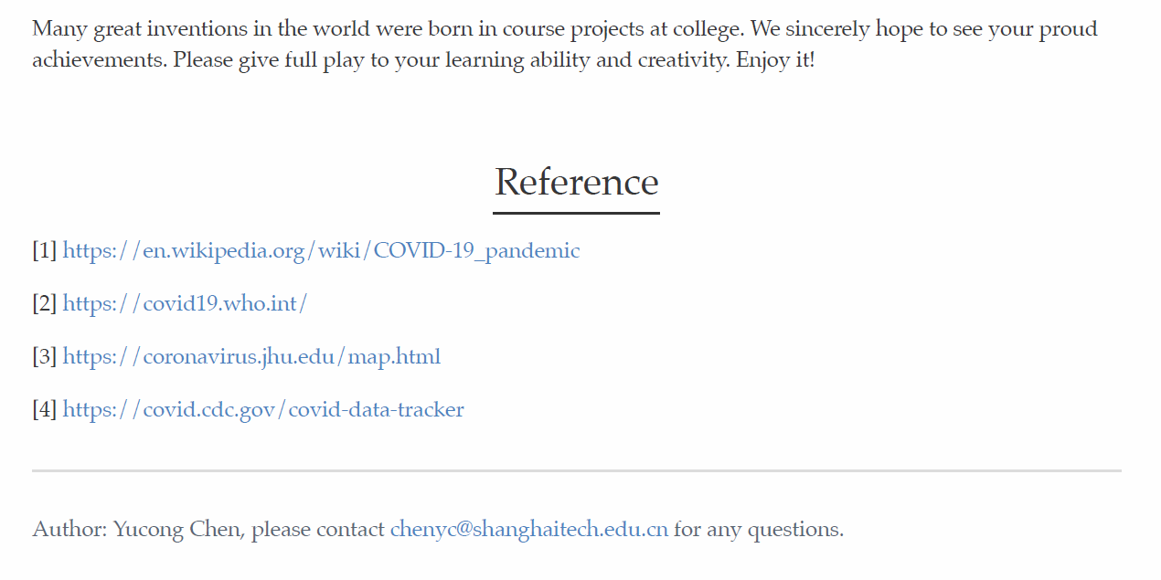

Slide 28
SPICE的诞生
时间回到1970年，在加州大学伯克利分校电机工程与计算机科学系（UCBerkeley , Dept. EECS），Ron Rohrer教授给七个研究生上“电路综合”课。Rohrer教授那时刚刚从仙童半导体公司（Fairchild Semiconductor）返回伯克利，没有时间准备教材。所以，在第一堂课，他就宣布：学生们一起写一个电路仿真程序。他跟系里的管教学的主任DonPeterson教授达成一个协议：只要Peterson教授认可学生们写的仿真程序，他们就全部通过。否则的话，他们就全部不及格。这七个学生中有一个还是从机械系来的。他感到十分委屈：教授啊，俺啥电路都不会，俺就是来学电路的。这倒好，电路没学到，反而要去写电路仿真程序。这可咋办啊？Rohrer教授想了想，说没关系。虽然电路你不懂，但你的数值分析不是很厉害吗？OK，你就负责解方程这块吧。最后的结果证明了恰恰是学生们自己开发的解稀疏矩阵的模块是一个亮点，它使得可处理的电路规模成倍的增大。
https://zhuanlan.zhihu.com/p/37442491

Slide 29
Learning Objectives
How a program runs on a basic computer
What is Python
How to get Python
Run a Python program
Basics about print and comments
Basic control flow

Slide 30
A basic computer
Generic
Computer
Software
Input
and Output
Devices
Central
Processing
Unit
Secondary
Memory
Main
Memory
Notes:
程序或者软件运行所依托的核心组件有两个，CPU和内存。
在运行之前，程序存在于外部存储器之中
用户通过输入设备通知CPU要运行程序，将程序载入内存
运行时被CPU从内存中获取程序指令，进行计算，结果存储于内存之中。
其中的部分数据又被存储回外部存储器上，或者通过输出设备反馈给用户

Slide 31
Definitions
Central Processing Unit: Runs the Program - Executing simple instructions (add, multiply, etc), one by one.
Input Devices: Keyboard, Mouse, Touch Screen
Output Devices: Screen, Speakers, Printer, DVD Burner
Main Memory: Fast small temporary storage - lost on reboot
Secondary Memory: Slower large permanent storage - lasts until deleted - disk drive / memory stick

Slide 32

How a program runs on a basic computer
What
Next?
Generic
Computer
Software
Input
and Output
Devices
Central
Processing
Unit
Secondary
Memory
if x< 3:
print(x)
Main
Memory
Programming
Language
Notes:
程序或者软件运行所依托的核心组件有两个，CPU和内存。
在运行之前，程序存在于外部存储器之中
用户通过输入设备通知CPU要运行程序，将程序载入内存
运行时被CPU从内存中获取程序指令，进行计算，结果存储于内存之中。
其中的部分数据又被存储回外部存储器上，或者通过输出设备反馈给用户
但是CPU无法直接理解例如。。。的高级程序语言，
程序会被编译成为0和1组成的机器语言，这样CPU才能够执行

Slide 33
How a program runs on a basic computer
What
Next?
Generic
Computer
Software
Input
and Output
Devices
Central
Processing
Unit
Secondary Memory
01001001
00111001
Main
Memory
Machine
Language

Slide 34
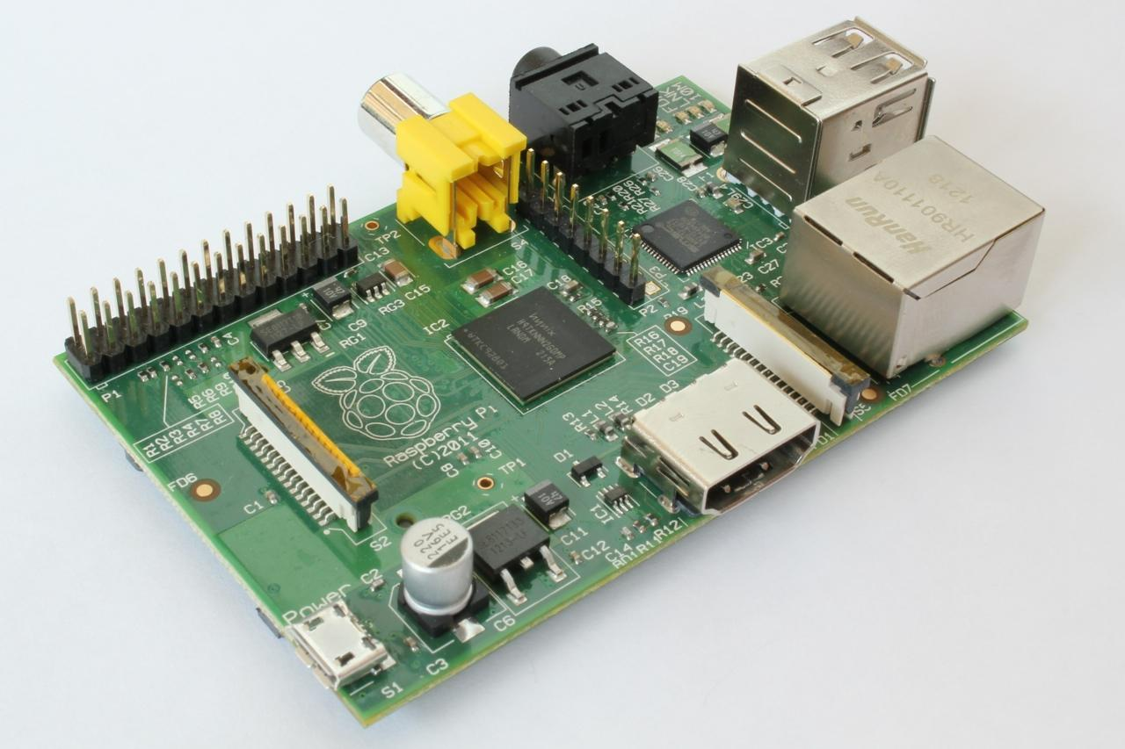
Basic Computer Architecture
A very simple computer (RaspberryPi)

Slide 35
A brief history of programming languages
In the late 1940s, the stored-program computer invented by John von Neumann, programs written in machine language, {0,1}+

Slide 36
A brief history of programming languages
Assembly language: in 1949 numeric codes were replaced by symbolic forms
Mov R, 2 (R=2)
Assembler: translate assembly language into corresponding machine language.
FORTRAN language and its compiler: between 1954 and 1957, developed by IBM

Slide 37
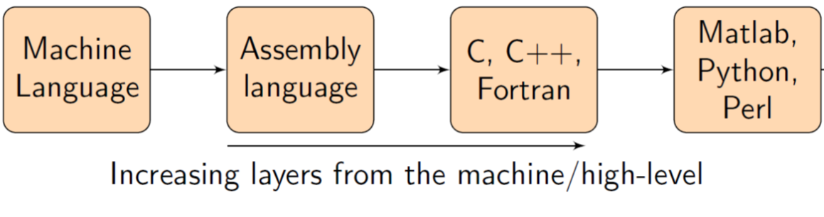
Programming Languages
Far from hardware, more human-friendly.
0101001…
ADD A B
calloc(200, sizeof(char));
my_list = [1, "Hello", 3.4]

Slide 38
How to pick a language?
Meet your application requirements
Must it be efficient?
Easy to understand
Easy to write (time, size of programs)
Easy to debug, maintain, and prevent errors
Plenty of support

Slide 39
Why Python?
Efficiency
efficient for programmers to write programs
but Python programs themselves are not efficient
Easy to learn
Active user community
Lots of handy packages
Lots of open source projects

Slide 40
And as a bonus
Once you learn how to code in one programming language it will be easier to learn another programming language, and another, and another…
C#, Java, C++, Perl…

Slide 41
A brief history
Invented by Guido van Rossum, started in 1989
"'hobby' programming project that would keep him occupied during the week around Christmas"
Top 5 popular programming languages
Ver 3.0 in 2008, limited backward compatibility

Slide 42
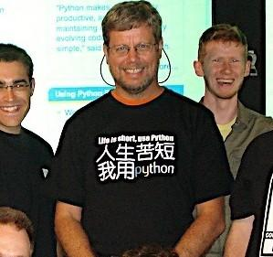

Slide 43
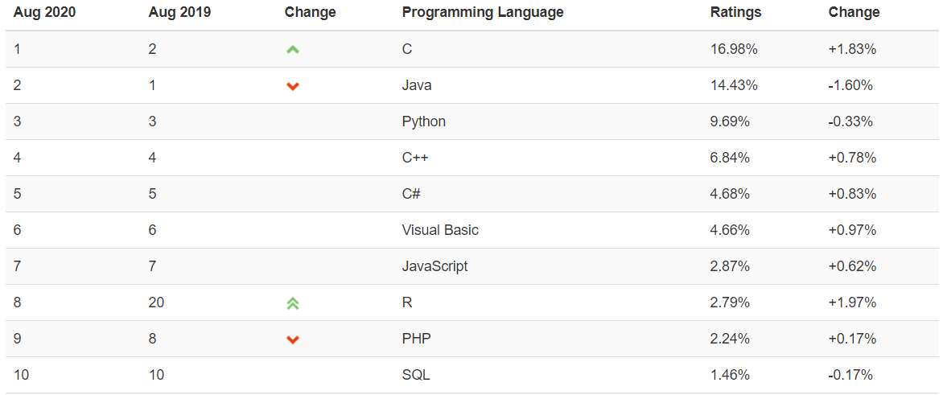
Growing popularity
Among top 5 by popularity
https://www.tiobe.com/tiobe-index/

Slide 44
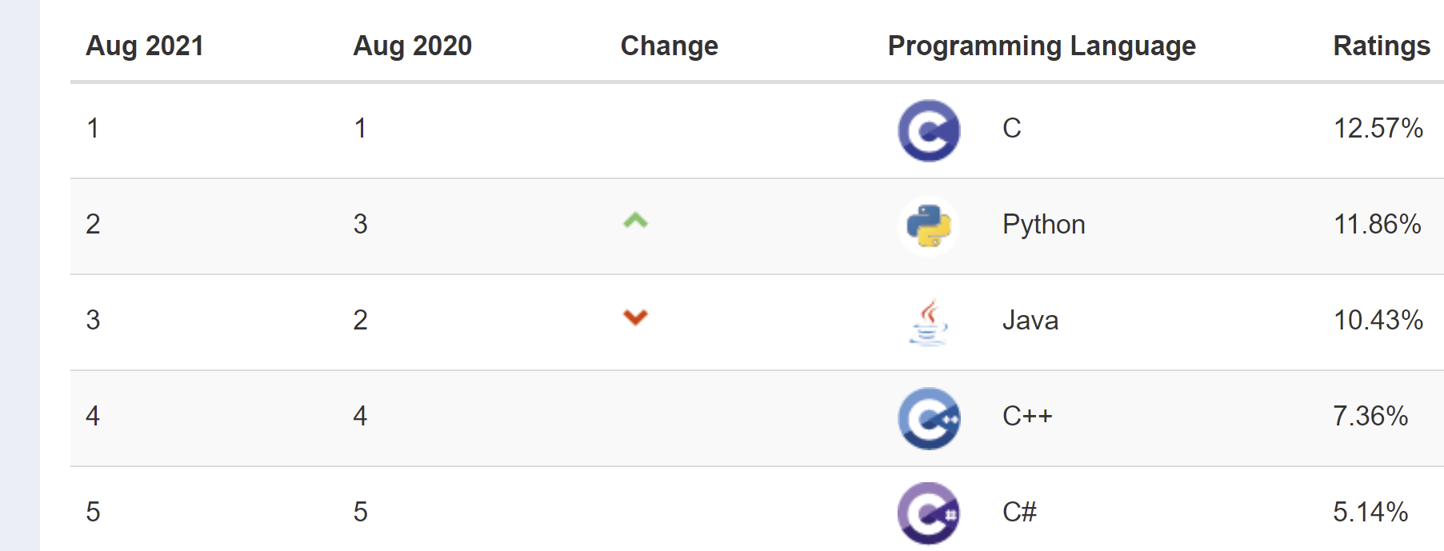

Slide 45






Who use Python?

Slide 46
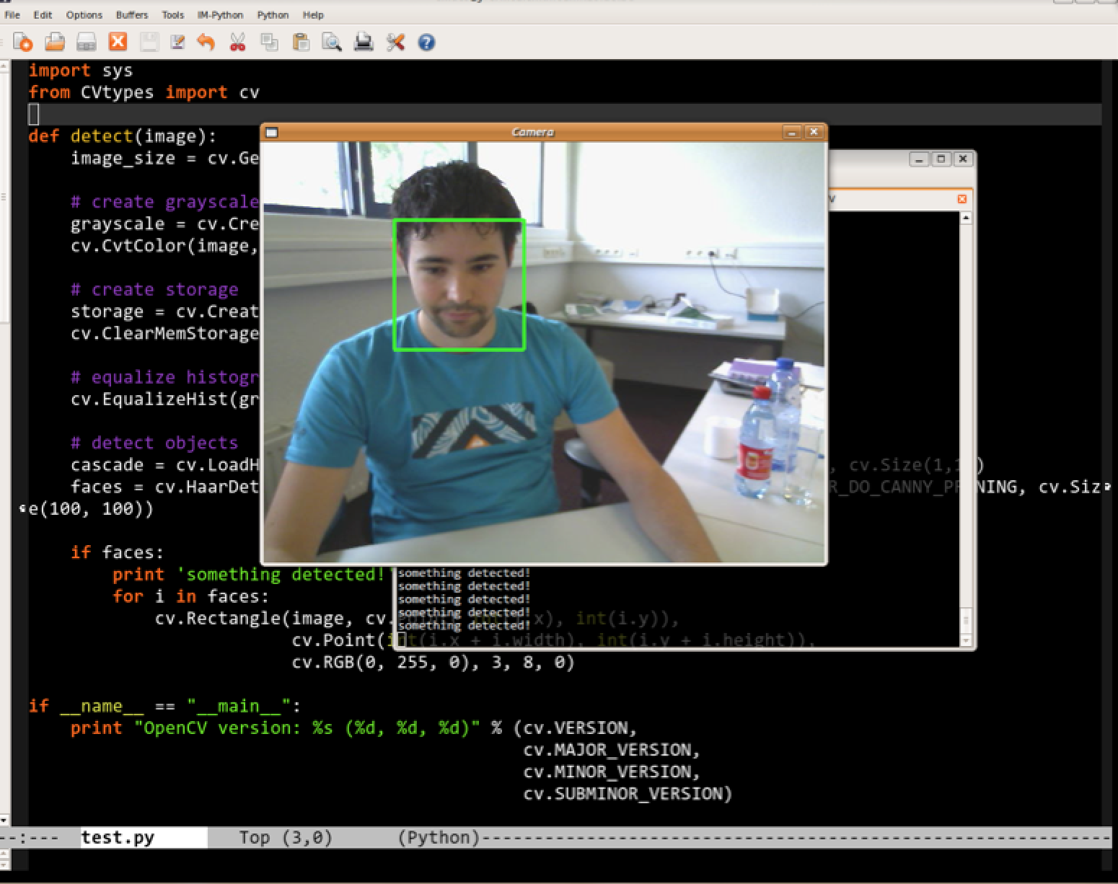
What can Python do?
Face recognition with OpenCV library

Slide 47
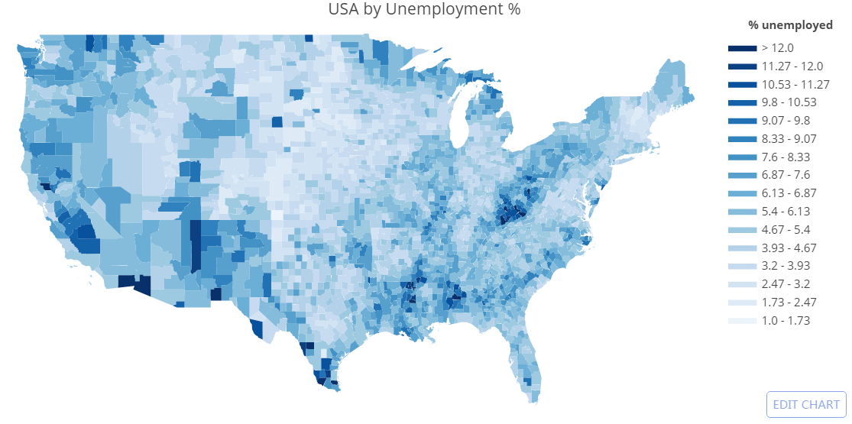
What can Python do?
Interactive visualizations and data analysis, https://plot.ly

Slide 48
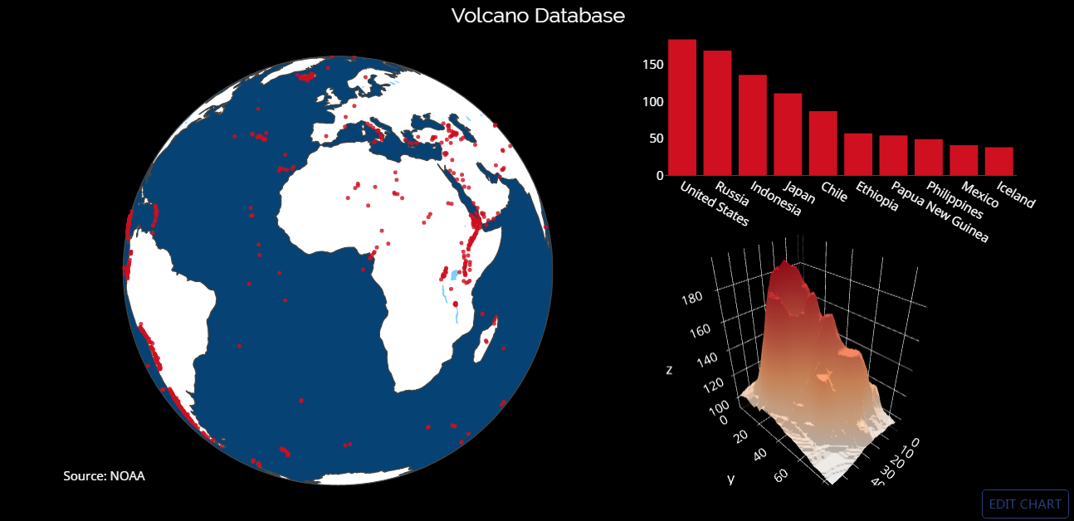
What can Python do?
Interactive visualizations and data analysis, https://plot.ly

Slide 49
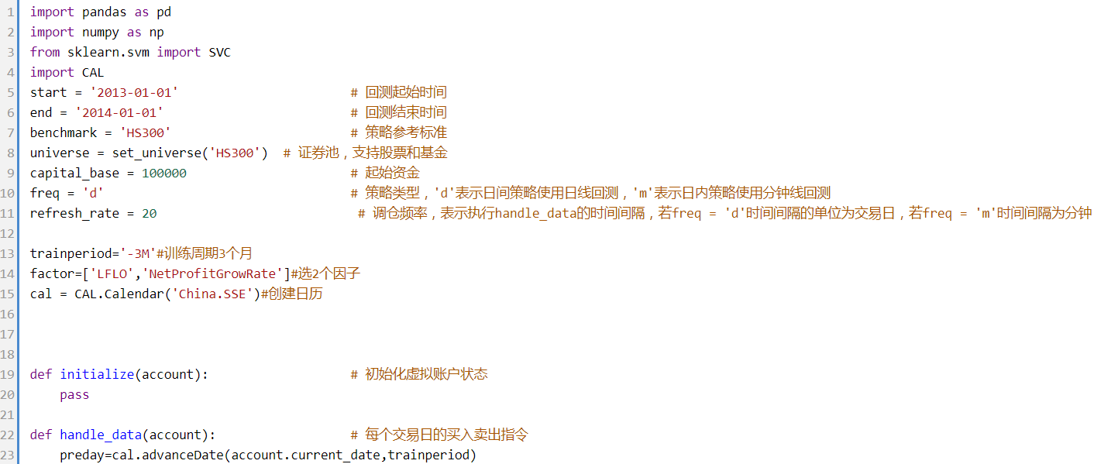
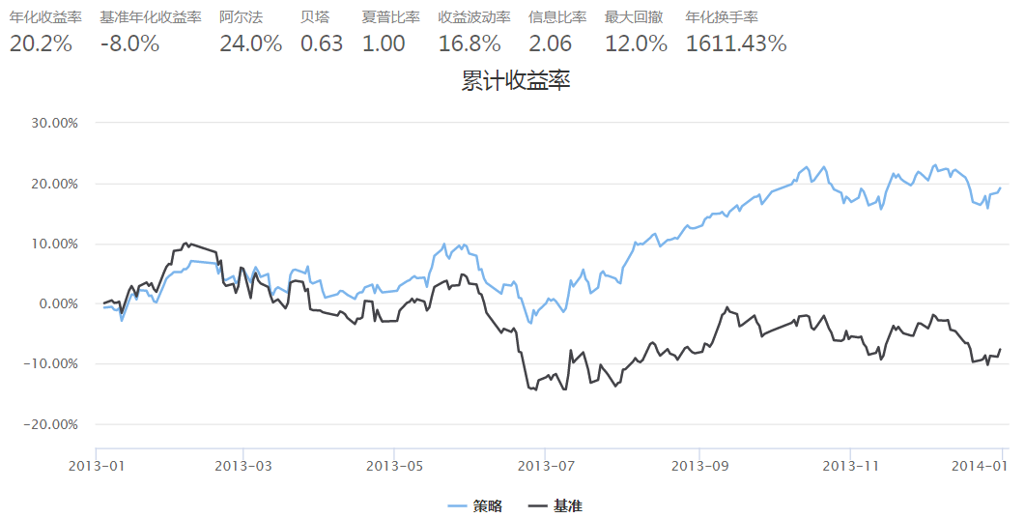
What can Python do?
Quantitative trading
https://uqer.io, write strategies and back-test them
A story about Bitcoin arbitrage system in 2014
http://daily.zhihu.com/story/4831821

Slide 50
What can Python do?
Computational biology, bioinformatics
combines biology, computer science, information engineering, mathematics and statistics to analyze and interpret biological data
https://biopython.org, computations on gene sequences

Slide 51
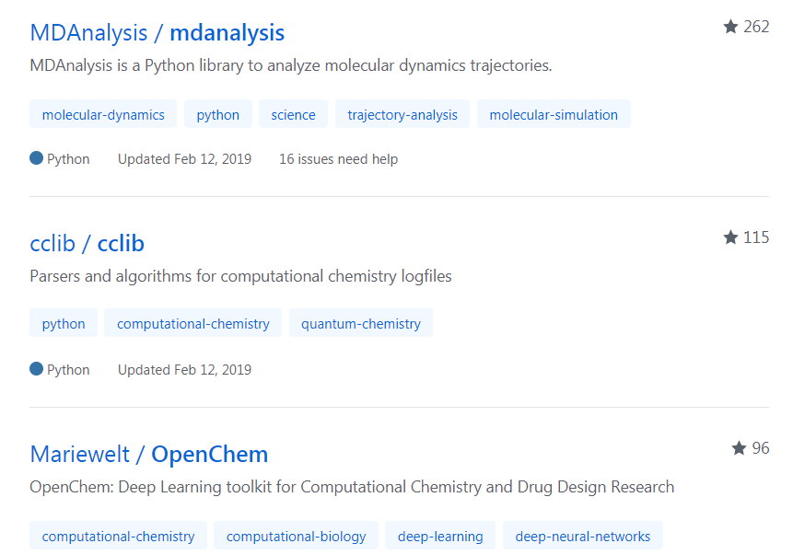
What can Python do?
Computational chemistry
uses methods of theoretical chemistry, incorporated into efficient computer programs, to calculate the structures and properties of molecules and solids.
Some active projects on Github

Slide 52
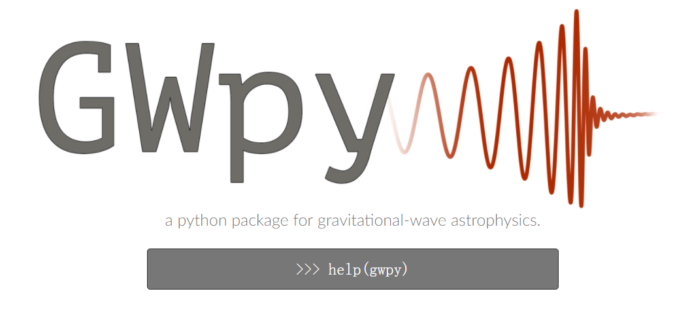
What can Python do?
2017 Nobel Prize in Physics
for decisive contributions to the LIGO detector and the observation of gravitational waves
https://gwpy.github.io/ , tools and methods for studying data from gravitational-wave detectors
Notes:
在广义相对论里，引力波是时空的涟漪。当投掷石头到池塘里时，会在池塘表面产生涟漪，从石头入水的位置向外传播。当带质量物体呈加速度运动时，会在时空产生涟漪，从带质量物体位置向外传播，这时空的涟漪就是引力波。爱因斯坦根据广义相对论于1916年预言了引力波的存在，2016年2月11日，LIGO科学团队与处女座干涉仪团队共同宣布，人类于2015年9月14日首次直接探测到引力波。

Slide 53
What can Python do?
Crawling web data
Beautifulsoup, Scrapy
E.g. Get rent price from 链家 and analyze the price trend
Statistics, scientific computing
statistics, numpy, scipy, pandas
Natural language processing
NLTK, Jieba; to understand human language
Machine learning/ Deep learning
SKLearn, Tensorflow, Pytorch

Slide 54
Social media data mining and e-commerce campaign

Slide 55
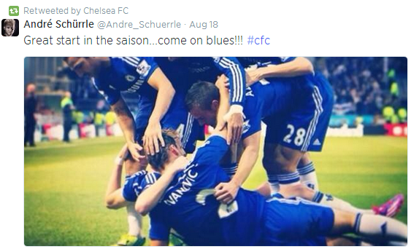
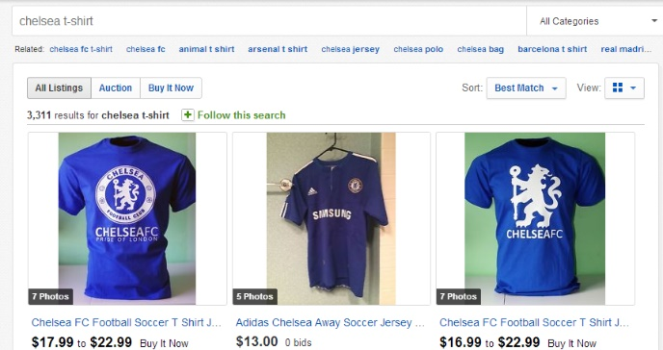
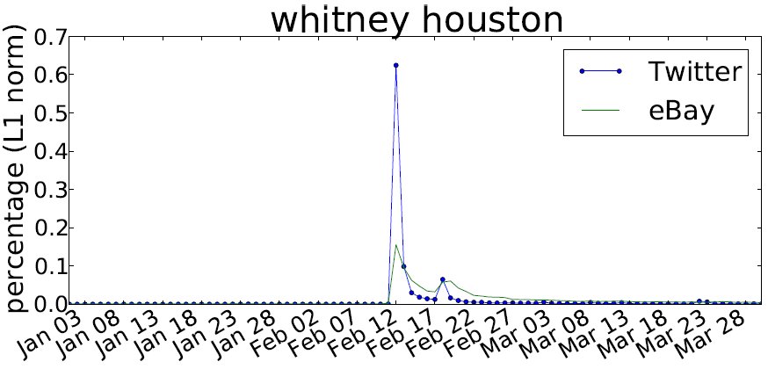
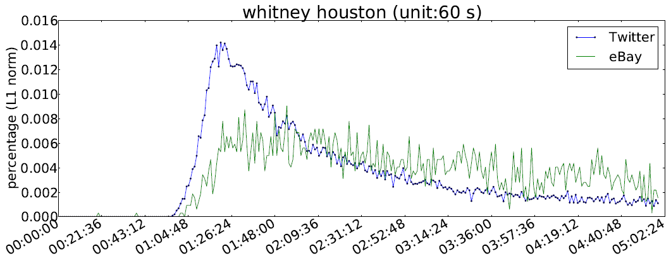
Twitter
eBay
Passed away
correlations
Funeral
lags
（4.8 hours）

Slide 56
Mining mobile user behaviors

Slide 57
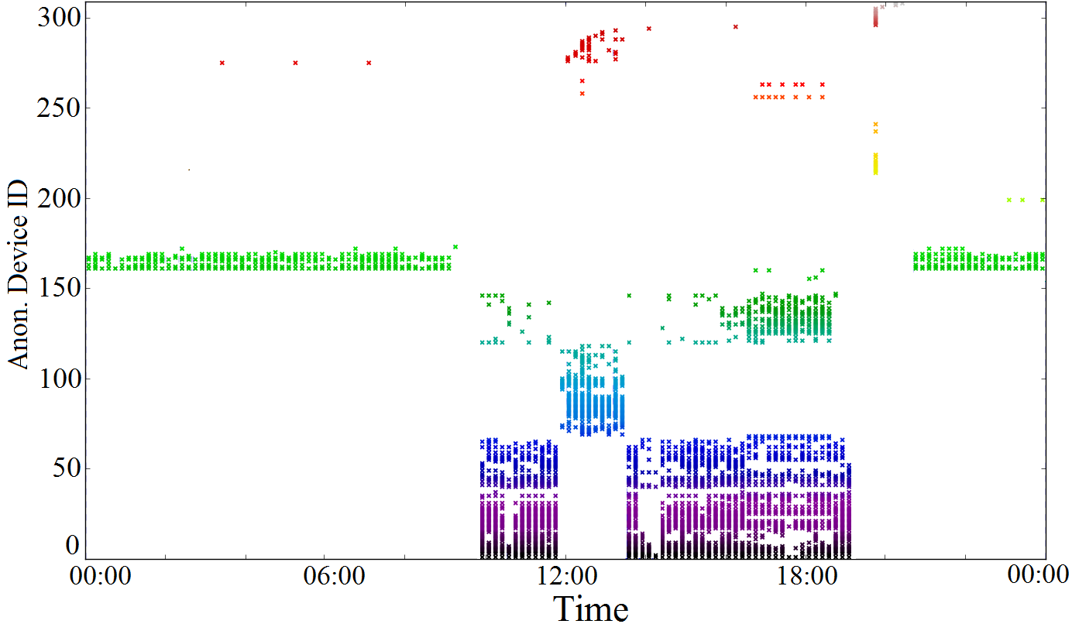
WiFi device ID discovered by a phone, in a day

Slide 58
WiFi device ID discovered by a phone, in a day
Home

Slide 59
WiFi device ID discovered by a phone, in a day
Home
Work

Slide 60
WiFi device ID discovered by a phone, in a day
Home
Work
Lunch

Slide 61
WiFi device ID discovered by a phone, in a day
Home
Work
Lunch
Work

Slide 62
WiFi device ID discovered by a phone, in a day
Home
Work
Lunch
Work
Home

Slide 63
Social media and stock market

Slide 64
Positive/negative social media sentiment and the stock market

Slide 65
How to get Python
Option 1, install Anaconda
Includes core Python environment, IDE (Integrated Development Environment). All in one.
Data science and visualization packages
Easy to manage (add, remove, update) packages
Python 3.8 version for this course.
https://www.anaconda.com/products/individual

Slide 66
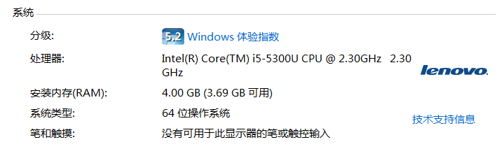
How to get Python
For Windows
Check your Windows bit, 64bit or 32bit, most often 64bit.
Download and install 64bit or 32bit Anaconda accordingly
https://repo.anaconda.com/archive/Anaconda3-2021.05-Windows-x86_64.exe 64bit

Slide 67
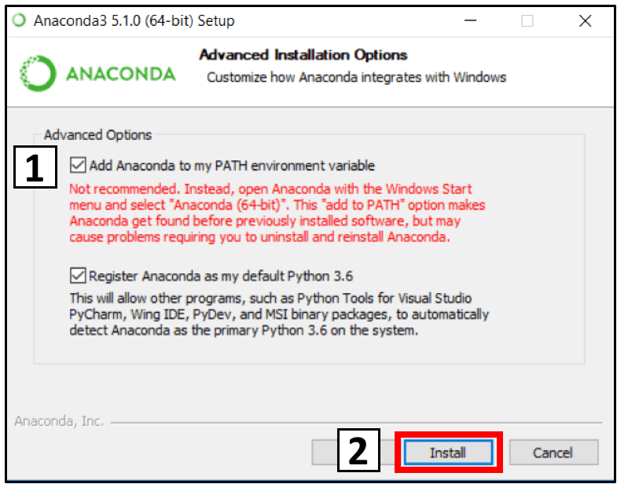
How to get Python
Recommend you check the first box

Slide 68
How to get Python
For Mac OS
https://repo.anaconda.com/archive/Anaconda3-2018.12-MacOSX-x86_64.pkg
For Linux
https://www.anaconda.com/distribution/#linux
Install according to your operation system bit and CPU (x86 or Power8/9)
After installation
Try the Spyder IDE, included in Anaconda
Or in Anaconda Prompt/command line/terminal, enter Python (depending on whether you have added Anaconda to your system path during installation)

Slide 69
How to get Python
Option 2, install Python from python.org
Download python 3.7.1 at www.python.org/downloads
32bit/64bit, Windows, Linux/UNIX, Mac OSX depends on your computer
Run python or idle in Windows
Type in python3 or python on Linux or Mac OSX
Two programming modes in Python
Interactive
Batch

Slide 70
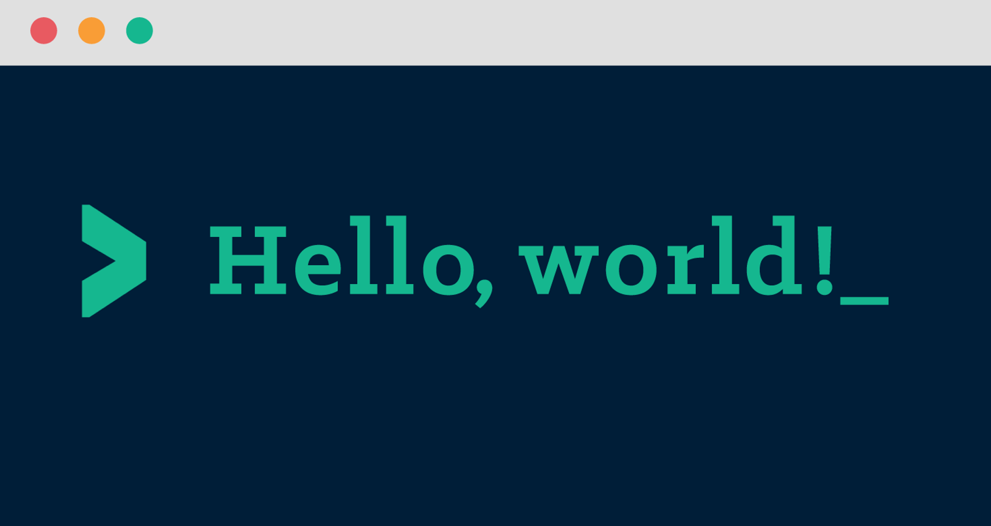
How do I know I installed everything correctly?
A tradition among programmers
always test installation by writing the same program

Slide 71
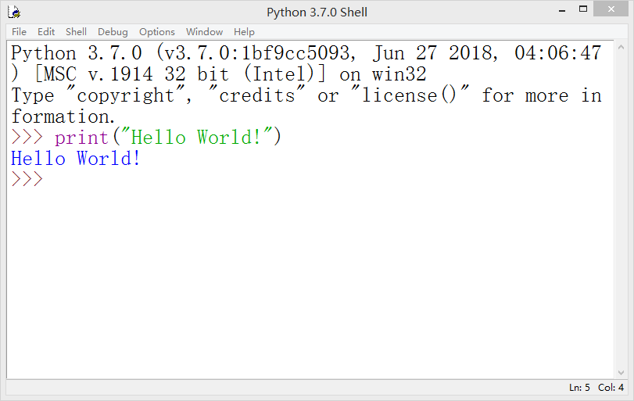
Step 1: Interactive programming
Start with Idle
Write instructions in console,
execute one block by one block
Usually for debugging

Slide 72
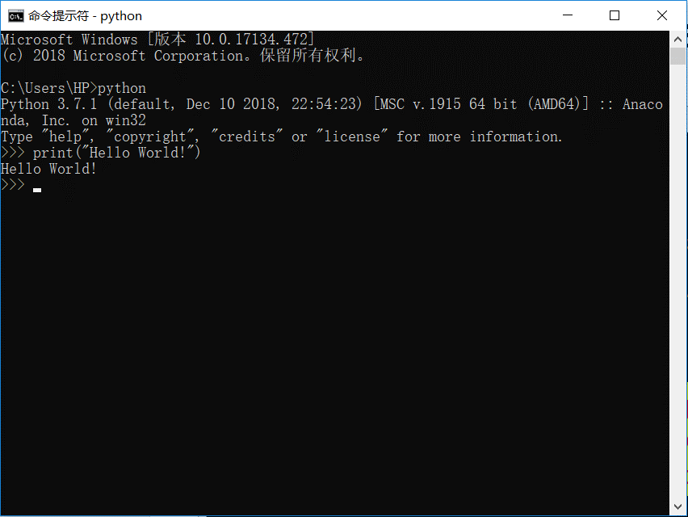
Step 1: Interactive programming
Start with python.exe
or type
Python in console

Slide 73
Step 2: Batch programming
Comment starts with #
Write instructions in a file hello.py,
execute the file by
python hello.py

Slide 74
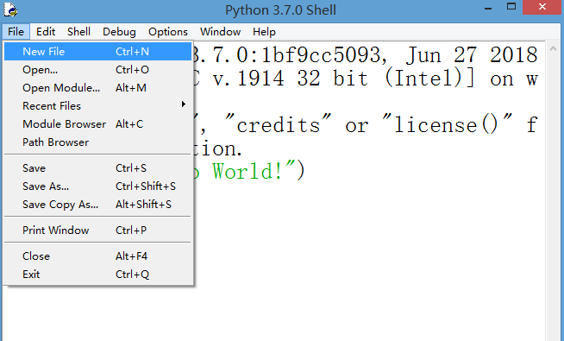
Step 2: Batch programming
In IDLE:
“File”==>“New File” create a file,
write your python program
save file as hello.py

Slide 75
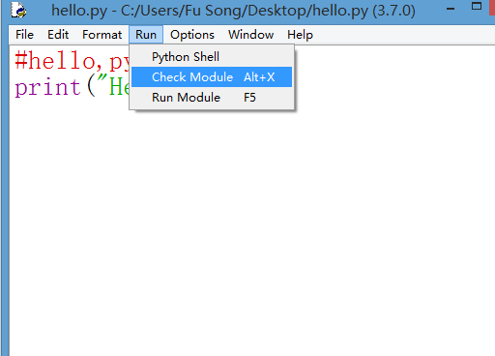
Step 2: Batch programming
In IDLE:
“File”==>“New File” create a file,
write your python program
save file as filename.py
“Run”==>”Check Module”
check syntax
5. “Run”==>”Run Module”
run the program and
print the result in IDLE

Slide 76
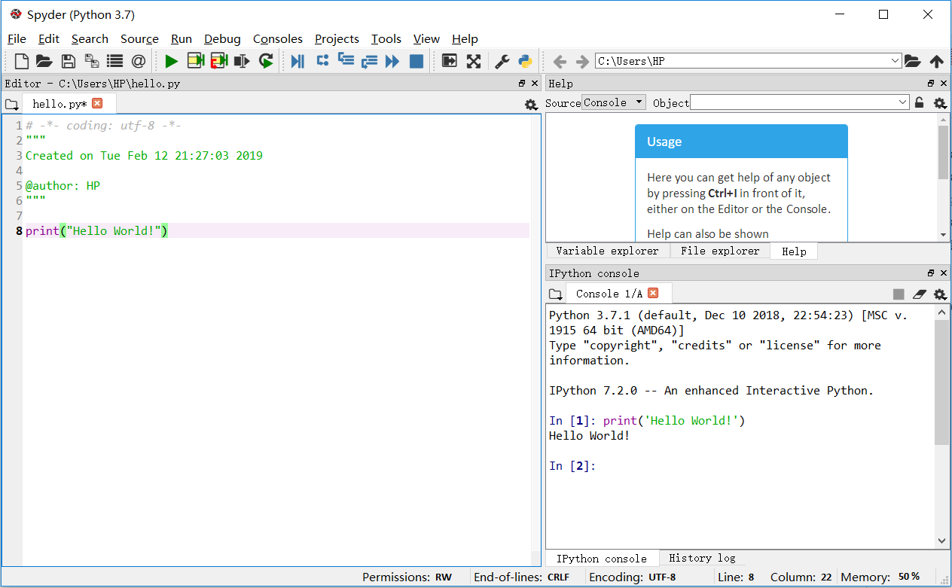
In Spyder (Anaconda)
Batch programming
Interactive programming

Slide 77
Print in Python
print a string: string needs to be surrounded by double or single quotes
print(“text”) or print(‘text’)
print() prints a blank line
https://docs.python.org/3/library/functions.html#print

Slide 78
Print in Python
What if we want the output to be:
Output
Hello World!
Hello World!
>>>
‘Hello World!’
“Hello World!”
>>>

Slide 79
Print in Python
We will use escape character (\)
‘Hello World!’
“Hello World!”
“Hello World!”
‘Hello World!’
>>>

Slide 80
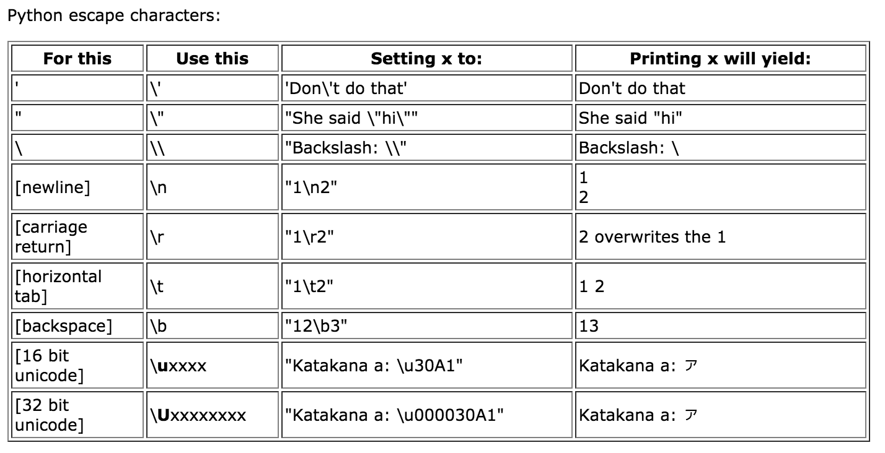
Print in Python

Slide 81
Print in Python
I'll say hello!
I'll say hello!
I'll say
hello!
>>>

Slide 82
Comments
Syntax:
# comment text (one line)
''' block
comment ''' (span over lines, use in pairs)
test.py
'‘’
Fall 2020, SIST
This program prints important messages.
'''
print("Hello, world!")
Print("") # blank line
print("I’ll say hello!")
Output:
Hello, world!
I’ll say hello!

Slide 83
Program steps or flow
Like a recipe or installation instructions, a program is a sequence of steps to be done in order.
Some steps are conditional - they may be skipped.
Sometimes a step or group of steps are to be repeated.

Slide 84
Sequential steps
x = 2
Program:
x = 2
print(x)
x = x + 2
print(x)
Output:
2
4
print(x)
x = x + 2
print(x)
When a program is running, it flows from one step to the next. As programmers, we set up “paths” for the program to follow.

Slide 85
Conditional steps
x = 5
x < 10 ?
Yes
Program:
x = 5
if x < 10:
print('Smaller’)
if x > 20:
print('Bigger’)
print('Finish’)
print('Smaller’)
No
Output:
Smaller
Finish
x > 20 ?
Yes
No
print('Bigger’)
print('Finish’)

Slide 86
Repeated steps
n = 5
No
n > 0 ?
Yes
Output:
5
4
3
2
1
Bingo!
Program:
n = 5
while n > 0 :
print(n)
n = n – 1
print(‘Bingo!')
print(n)
n = n -1
print(‘Bingo!')
Loops (repeated steps) have iteration variables that change each time through a loop. Often these iteration variables go through a sequence of numbers.
86

Slide 87
Readings (recommended)
The Python Tutorial
Chapter 3: An Informal Introduction to Python

Slide 88
Recap
How a programs runs on a basic computer
What is Python
How to get Python
Run a Python program
Basics about print and comments
Basic control flow

Slide 89
https://cloud.tencent.com/developer/article/1817699
https://cloud.tencent.com/developer/article/1754001?from=article.detail.1817699
https://cloud.tencent.com/developer/article/1873382?from=article.detail.1754001

